Slide 1
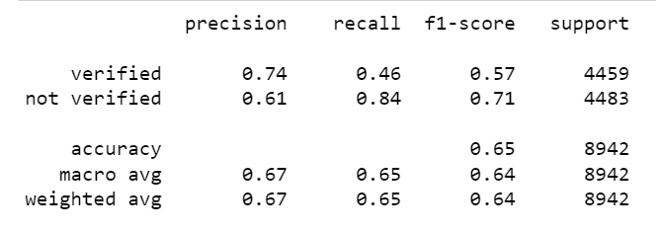
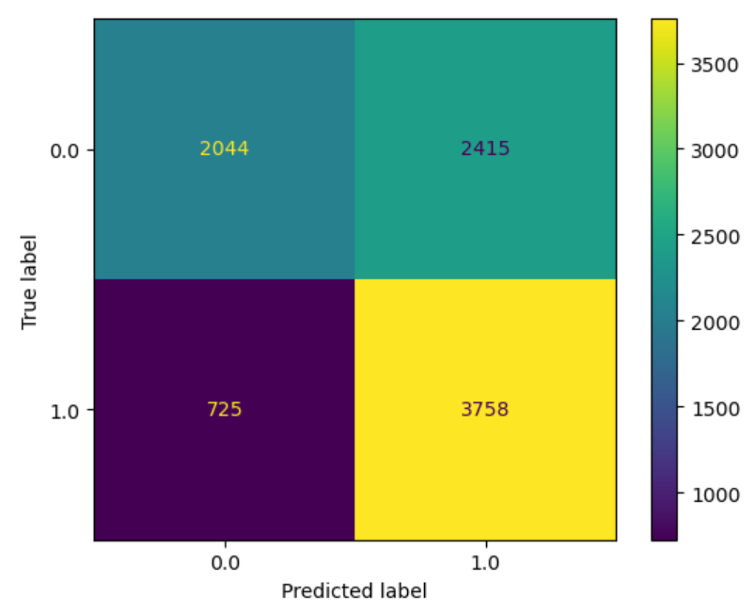
Executive Summary of Regression Analysis
Presented by TikTok data team
TikTok leadership ask data team to develop a predictive model that can determine whether a video contains a claim or offers an opinion to reduce the backlog of user reports and prioritize them more efficiently. Continuing from last part, the data team observed that if the user is verified, it is more likely to post opinions. In this part of project, the data team built a logistic regression model that predicts verified_status, so the model can shows how to predict the behavior of the verified account type tends to post more opinions.
The verified_status variable was selected because of the relationship between the verified account and the video content.
Logistic regression model was selected because of the data type (categorical) and distribution.
Logistic regression model achieved a 67% precision score and 65% recall score (weighted averages), and also 65% f1 accuracy score.
Based on the estimated model coefficients from the logistic regression, longer videos more likely to be associated with verified users.
Based on the result, only video length has association with verified status. While the other video features’ association with verified status seem to be small, hence not associated with verified status.
The next step will be constructing a classification model that predict the status claims made by users. This will be the final project and end goal expectation from the TikTok team.
Upper left and upper right matrix's are posted by unverified accounts, while lower left and lower right matrix’s are posted by verified accounts.

